Slide 1
CS 2212
Introduction to Software Engineering
Chapter 8 Requirements Modeling

Slide 2
Copyright Notice This Presentation and Its Associated Video Contain Copyright Material. This Presentation and Its Associated Video Are Provided for Teaching Purposes of CS2212 and Should Not Be Posted In Any External Site, Or Shared with. This Presentation and Its Associated Video Are Provided For Instructional Personal Use Only, and Only For The Purposes of the CS2212 Course.

Slide 3
Part 16
UML Use Case Descriptions and Use Case Diagrams
Adding more software engineers to an already late software project makes it even later.
- Fred Brooks
Notes:
This lesson introduces the basic steps in a software engineering project at a high level.
In practice, steps often overlap.

Slide 4
Learning Objectives in this Part
To understand the concept of a Use Case Model
To learn the notation and semantics of UML Use Case Diagrams

Slide 5
Use Cases
Use Case
It is a result of factoring / amalgamating several related usage scenarios
A use case defines and describes the interaction between
Actors (i.e. system users, stakeholders)
Specific parts of the application (i.e. system services)
That is a use case defines in a systematic and methodical way the functionality described by a collection of related scenarios
Many use cases finally cover the whole breadth of the desired system behavior and functionality
To compile use cases we consider normal scenarios (i.e. specify vanilla behavior), and pathological scenarios (i.e. specify extreme, alternative, or non-standard system behavior and state)

Slide 6
Flow of Events in a Use Case Description
The normal execution path (everything goes well) (“Happy Path”)
One or more alternative paths
Normal cases
Odd cases
Extreme cases
Pathological cases
“Happy Path”

Slide 7
Use Case Example: Change of Airline Ticket Reservation
Actors: traveler, airline data base, airline reservation system
Preconditions:
The traveler has already logged-in in the system and has selected the “change booking” option
Base use case route:
The system retrieves information related to bookings of the user from its data base
The system prompts the user to select a specific flight; The traveler selects a specific flight
The system prompts the traveler to select a new departure time/date; the traveler provides the required information
If the flight has seats available ...
…
The system confirms the changes provides a summary of the changes.
Alternative use case route:
If the flight does not have seats available then …

Slide 8
Steps for Functional Requirements Modeling
Steps:
Initial idea
Repeat steps 3-5 until all functional requirements have been specified 3-5
3. Determine and define scenarios
4. Group scenarios in use cases
5. Factor, unify, simplify related use cases
6. Describe each use case as structured text (the use case description with its process steps). Include happy path, alternative paths, pathological paths
7. Complete a use case diagram for the use case (you may need additional use case diagrams for the alternative or pathological use case paths)
Use Case Model = Use Case Description + Use Case Diagram. We have one use case model for each functional requirement presented by the user
Functional Requirements Specification = Use Case Models (one for each use case) + Sequence Diagrams (one for each Use Case) + Communication Diagrams (one for each use case) + Supporting material
Requirements Specifications = Functional Requirements Specification + Non-functional Requirements Specification + Supporting material

Slide 9
Modeling with UML
Requirements Modeling | Scenarios, Use Case Diagrams
Static Modeling | Class Diagrams Object Diagrams Component Diagrams Deployment Diagrams
Dynamic Modeling | Sequence Diagrams Collaboration Diagrams – Communication Diagrams στη UML 2.0
Modeling the behavior of specific objects/classes | State Diagrams
Modeling the execution of system process steps | Activity Diagrams
Modeling system
operation – user’s
view
System
Structure
Modeling
System
Behavior Modeling

Slide 10
Relationship of Use Case Models with other UML Models
Use Case Model
Is achieved by
Is verified by
Is implemented by
Design Model
Implementation Model
Test Model

Slide 11
Use Case Diagrams
We will discuss now UML Use Case diagrams. A Use Case diagram is a representation of a user's interaction with the system that shows the relationship between the user and the different processes (i.e. other use cases) required to implement a use case. In general there is one Use Case diagram for each use case provided by the user.
Use case diagrams attempt to mimic the real world and provide a view for the stakeholder to understand how actors interact with the system’s processes for a given use case.
Additional diagrams and documentation can be used to provide a complete view of system requirements. We will discuss these diagrams later in the class. These diagrams include:
Sequence Diagrams
Activity Diagrams
Domain Model

Slide 12
Structural Elements of Use Case Diagrams (1)

Slide 13
Structural Elements of Use Case Diagrams (2)
<<extend>>

Slide 14
Structural Elements of Use Case Diagrams (3)
<<include>>

Slide 15
Use Case Diagram Example
An entity can play the
role of one or more
agents at the same
time
Billing
System

Slide 16
Use Case Diagram Example

Slide 17
Use Case Diagram Example

Slide 18
<<include>>, <<extend>> Stereoptypes
<<extend>>
(set priority)
Place order
Extension points
set priority
Place
rush order
<<include>>
Subtyping link
Check
password
Track order
<<include>>
Validate user
Retinal scan

Slide 19
Use Case Model = Use Case Diagrams + Use Case Descriptions
Use Case Model
Mnemonic name for the use case
Use case outline
Events/steps for the use case
Pre-conditions
Post-conditions
Use Case Descriptions (structured text)
Use case diagrams
Other special requirements
Actors
Use Case / Operation
...
Use Case Descriptions

Slide 20
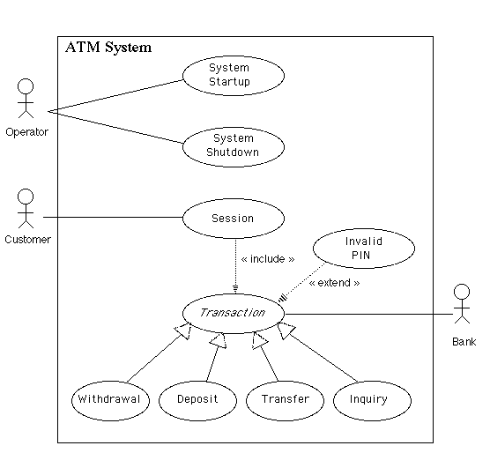
Use Case Diagram Example
http://www.math-cs.gordon.edu/local/courses/cs211/ATMExample/Intro.html

Slide 21
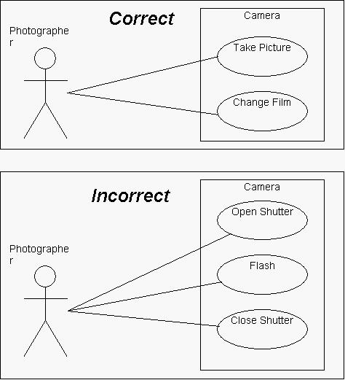
Use Case Diagram Example
http://www.andrew.cmu.edu/course/90-754/umlucdfaq.html

Slide 22
Your Turn
What is a use case model and what is it composed of? Explain.
What use case diagrams are used for?
What is a use case description and what is a use case diagram?
What is the difference between the <<extends>> and the <<includes>> stereotype in use case diagrams?
What is the difference between the use of the <<extends>> stereotype and the use of subtyping?
Check-out the content of the following sites:
https://www.uml-diagrams.org/
https://www.uml-diagrams.org/use-case-diagrams.html (Also check-out the individual menu tabs on this use case diagrams page)
http://www.agilemodeling.com/artifacts/useCaseDiagram.htm
https://creately.com/blog/diagrams/use-case-diagram-relationships/

Slide 23
Part 16 - Examples
UML Use Case Descriptions and Use Case Diagrams
Adding more software engineers to an already late software project makes it even later.
- Fred Brooks
Notes:
This lesson introduces the basic steps in a software engineering project at a high level.
In practice, steps often overlap.

Slide 24
Learning Objectives in this Part
To delve into examples of Use Case Descriptions and Use Case Diagrams

Slide 25
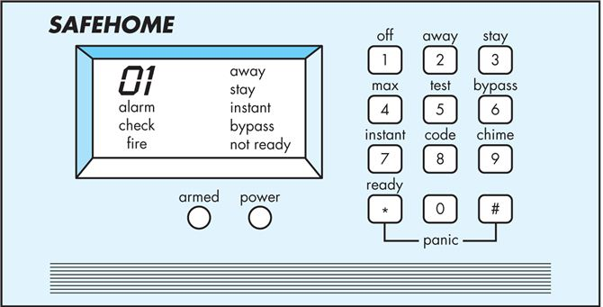
Example Use Case (Home Alarm System)

Slide 26
Example Use Case Description
Use case: | Initiate Monitoring
Primary actor: | Homeowner
Goal in context: | To set the system to monitor sensors when the homeowner leaves the house or remains inside
Preconditions: | System has been programmed for a password and to recognize various sensors
Trigger: | The homeowner decides to “set” the system, that is, to turn on alarm functions

Slide 27
Example Use Case Description
Scenario: Homeowner observes control panel Homeowner enters password Homeowner selects “stay” or “away” Homeowner observes alarm light to indicate that SafeHome has been armed
Exceptions: Control panel is not ready. Homeowner checks all sensors to determine which are open and closes them. Password is incorrect (control panel beeps once). Homeowner reenters correct password. Password not recognized. Monitoring and response subsystem must be contacted to reprogram password. “Stay” is selected. Control panel beeps twice and a “stay” light is lit. Perimeter sensors are activated. “Away” is selected. Control panel beeps three times and and “away” light is lit. All sensors are activated.

Slide 28
Example Use Case Description
Priority: | Essential, must be implemented
When available: | First increment
Frequency of use: | Multiple times per day
Channel to actor: | Via control panel interface
Secondary actors: | System administrator, sensors
Channels to secondary actors: | System administrator: phone line Sensors: hardwired and radio frequency interfaces

Slide 29
Example Use Case Description
Open Issues: Should there be a way to activate the system without the use of a password or with an abbreviated password? Should the control panel display additional text messages? What about voice messages? How much time does the homeowner have to enter the password from the time the first key is pressed? Is there a way to deactivate the system before it actually activates?

Slide 30
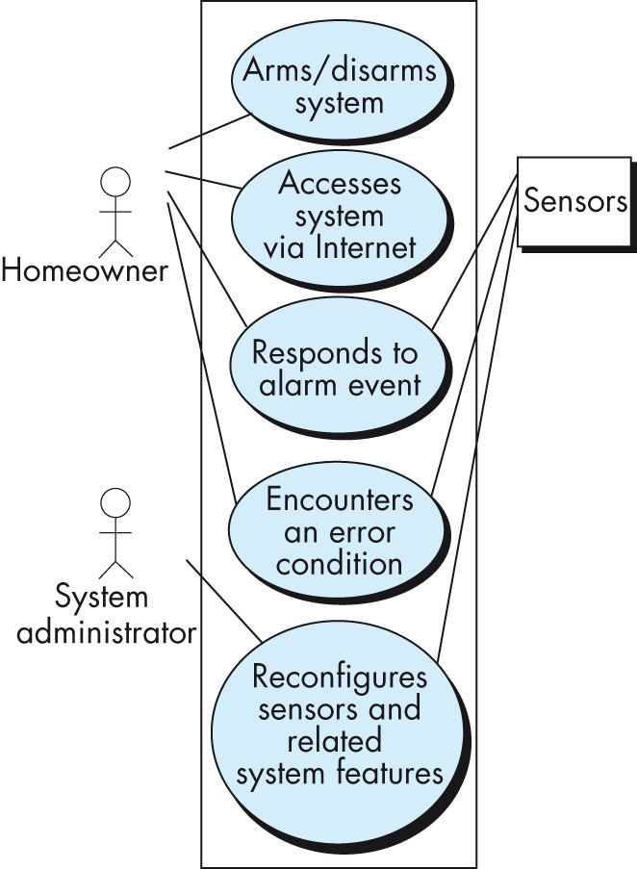
Example (top Level) Use Case Diagram for Home Alarm System

Slide 31
More Examples

Slide 32
Review Example 1 Use Case Diagram
http://elearning.uml.ac.at/

Slide 33
Review Example 2 Use Case Diagram
http://elearning.uml.ac.at/

Slide 34
Review Example 3 Use Case Diagram
http://elearning.uml.ac.at/

Slide 35
Review Example 4 Use Case Diagram
http://elearning.uml.ac.at/

Slide 36
Review Example 5 Use Case Diagram
http://elearning.uml.ac.at/

Slide 37
Review Example 6 Use Case Diagram
http://elearning.uml.ac.at/

Slide 38
Review Example 7 Use Case Diagram
http://elearning.uml.ac.at/

Slide 39
Review Example 8 Use Case Diagram
http://elearning.uml.ac.at/

Slide 40
Final Thoughts on Use Case Diagrams
Use case diagrams are helpful in ensuring that you have covered all of the functionality of the system as you get to see the system as a whole
Note that none of the details of use cases are included in the diagrams, however, and such details need to be stored separately
These details are still important to the software development process, and are often considered to be more important that the overall use case diagram

Slide 41
Your Turn
Provide a more detailed use case diagram for the Home Alarm System Use case presented in slides 22-26 and use the <include>> or <<extend>> stereotypes.
What a link between an actor and an activity means in a use case diagram?
What a subtyping (generalization/specialization) link means between two actors in a use case diagram?
What a subtyping (generalization/specialization) link means between two activities in a use case diagram?
What is the difference between the <<include>> stereotype and a generalization/specialization link between two activities in a use case diagram.
What is the difference between the <<extends>> stereotype and a generalization/specialization link between two activities in a use case diagram.
Check-out the content of the following sites:
https://www.tutorialspoint.com/uml/uml_use_case_diagram.htm
http://elearning.uml.ac.at/
http://www.math-cs.gordon.edu/courses/cs211/ATMExample/

